Slide 1





SMARTSHELFX – INVENTORY FORECAST & AUTO-RESTOCK
Team Members :
Varun Namdev
Lavanya Janarthanan
Ravi Aluri
Suraj Thoke
Danisa Subhani
Warle Shreekant
Mentor : Suramya Biswas

Slide 2
Agenda
INTRODUCTION
KEY OUTPUTS
01
04
Gives an overview of the project, explaining its purpose, goals, and the problem it aims to solve.
Highlights the major results, reports, or outcomes generated after implementing the system successfully.
TEHCNOLOGY STACK
FUTURE ENHANCEMENTS
02
05
Contains the technologies, tools, and frameworks used in developing and implementing the entire application.
Mentions the possible improvements, additional features, or upgrades planned for future versions of the project.
IMPLEMENTED MODULES
CONLUSION
03
06
Describes the main modules or components that have been developed and integrated within the system.
Summarizes the overall work, key learnings, and effectiveness of the project in achieving its objectives.

Slide 3
INTRODUCTION
01
SmartShelfX is an inventory management system designed to automate stock monitoring and restocking.
02
It uses Stock keeping unit (SKU)-based tracking to manage and analyze all product details efficiently.
03
The system provides real-time analytics for both single products and the entire inventory.
04
Transaction In and Transaction Out history is maintained for complete stock movement transparency.
05
Users can add, view, issue, update, and delete products or Stock keeping unit easily
06
Role-based dashboards are available for Admin, Manager, and Vendor for better control and visibility.
07
The platform aims to reduce manual workload and optimize inventory operations using intelligent insights.

Slide 4










React JS
Spring Security
Java Spring Boot
RDBMS MySQL 8
Technology
Overview
VS Code
IDE
Eclipse
IDE
Spring data
JPA
Chart JS

Slide 5

IMPLEMENTED MODULES
USER AND ROLE MANAGEMENT
USER AND ROLE MANAGEMENT
STOCK IN AND STOCK OUT
User Registration & Login
Add Products and View Product List
Stock In (Purchase Entry)
Role-based Access Control
Update & Delete Products
Stock Out (Issue Entry)
Password Encryption
Purchase & Issue Operations
Reorder Level Check:
Stock Monitoring
Admin Controls
Transaction History:
Unique Identifiers Product ID & SKU ID
SKU MANAGEMENT
ALERTS AND NOTIFICATIONS
ANALYTICS DASHBOARD & REPORTS
Unique SKU Id Generation
Low Stock Alerts
Real-time Updates
Quick Search & Filtering
Reorder Notifications
Graphical Reports
Error Prevention
Purchase/Issue Confirmation Alerts
Overall Analytics Dashboard
Product Identification:
Error & Warning Messages
Single Product Analytics

Slide 6
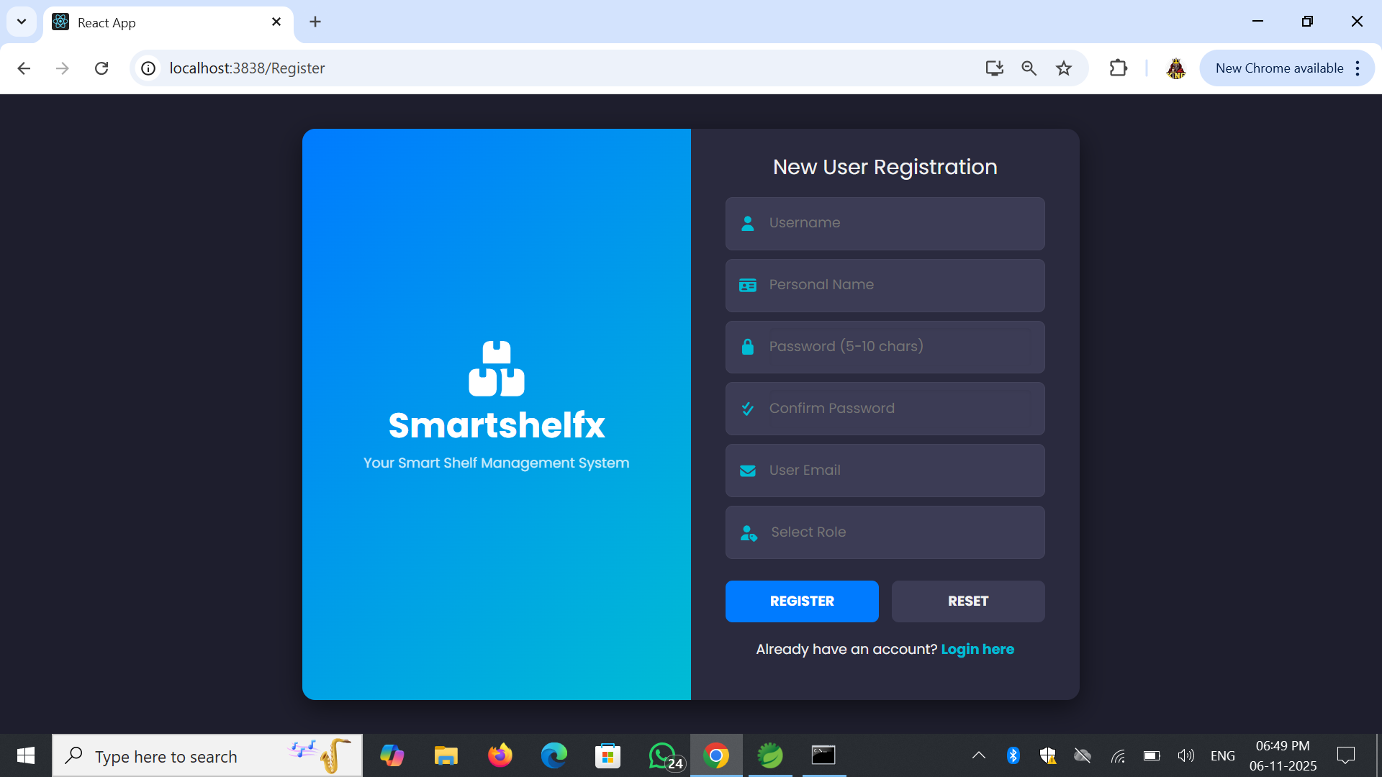
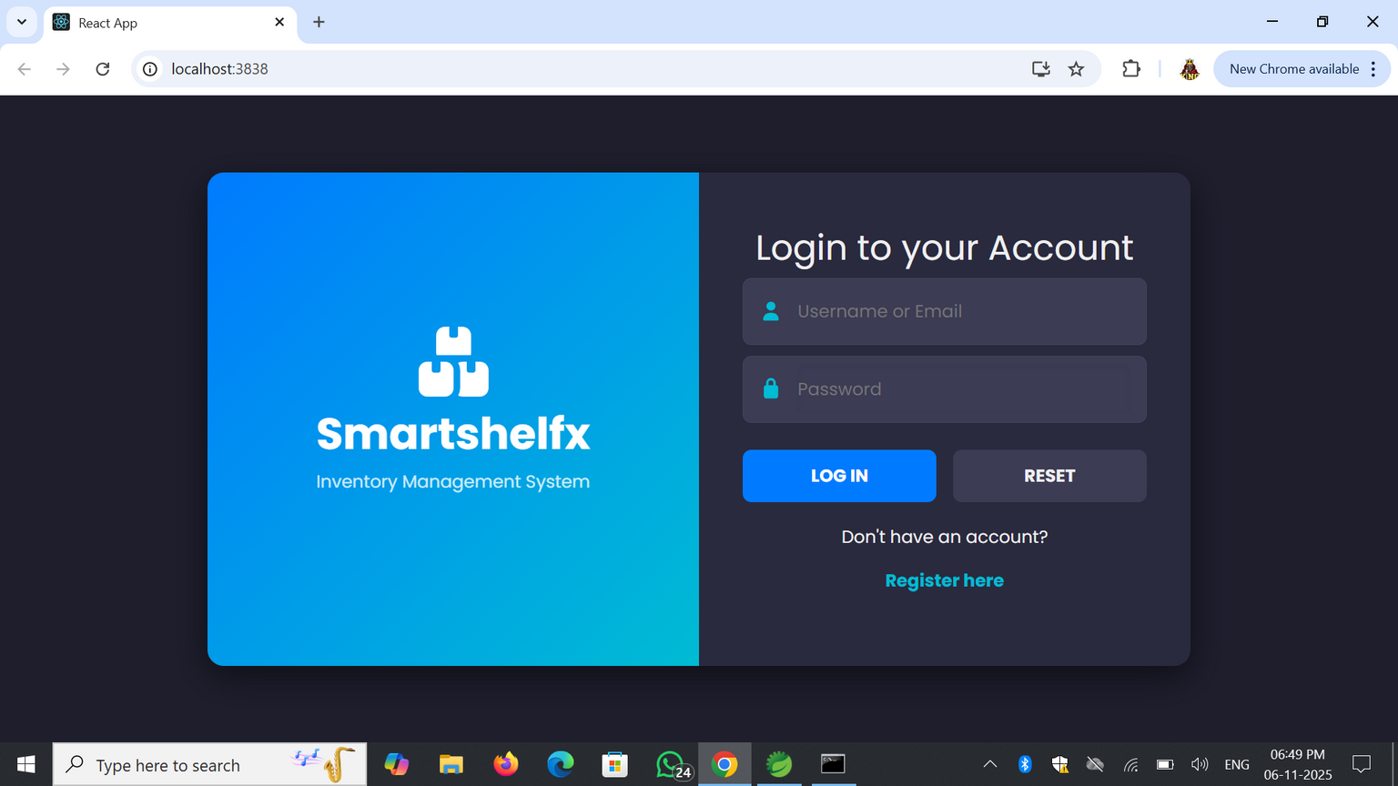
Key Outputs
LOGIN PAGE:
NEW USER REGISTRATION:
Provides a secure login interface where users can access the system using valid credentials. Ensures role-based authentication for different user types.
Allows creation of new accounts by collecting essential user details such as name, email, password, and role. Ensures smooth onboarding for new users.

Slide 7
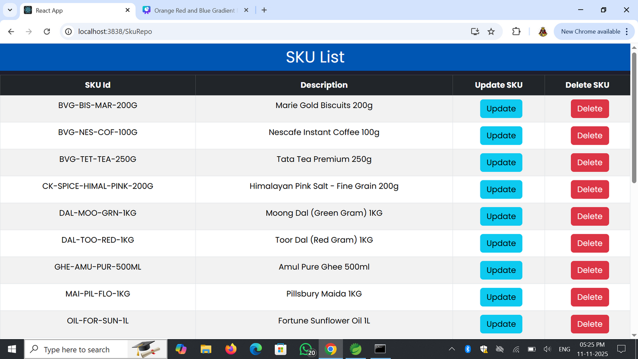
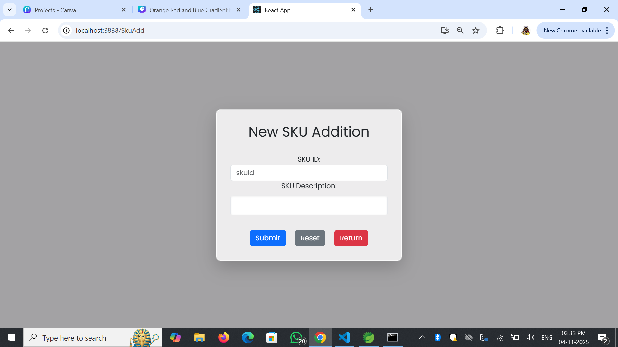
ADD NEW SKU PAGE:
SKU LIST PAGE:
Allows users to easily add new Stock Keeping Units (SKU) with ID and description, simplifying inventory expansion and data accuracy.
Displays all available Stock Keeping Units SKUs with options to update or delete, ensuring efficient product tracking and management.

Slide 8
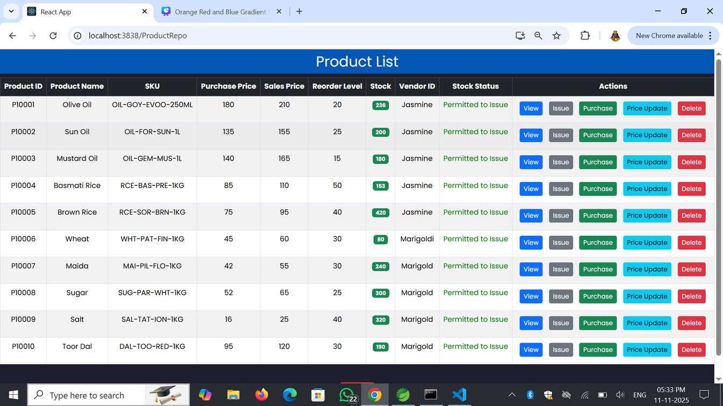
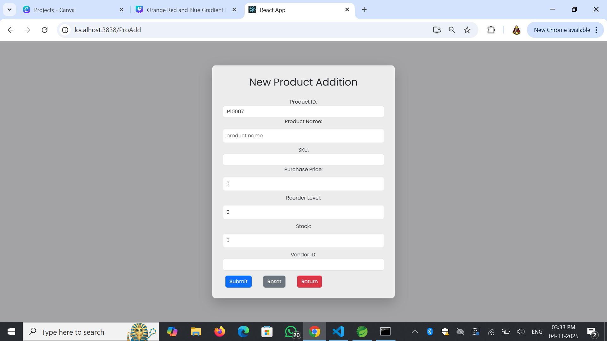
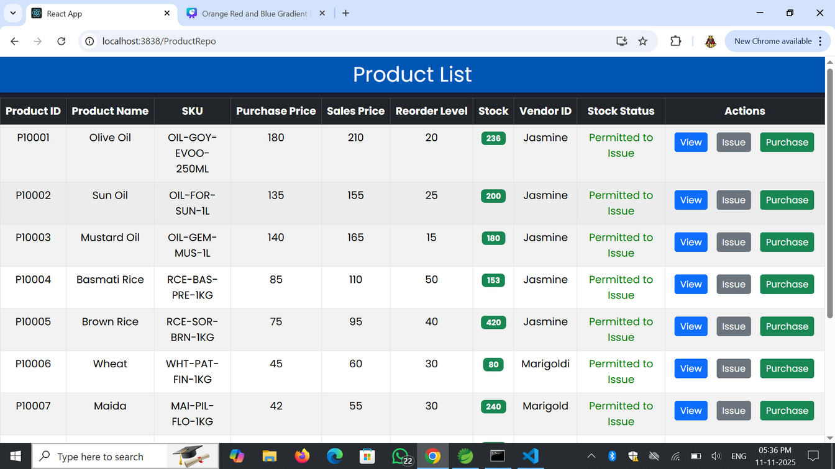
PRODUCT LIST PAGE:
NEW PRODUCT ADDITION PAGE:
Displays all product details including price, stock, and vendor information. Admin can perform key actions like viewing, issuing, purchasing, price updates, and deletion. Shows essential product data with limited access for managers to view, issue, or purchase
Allows seamless entry of new product data with fields for pricing, stock, reorder level, and vendor, ensuring accurate inventory tracking.

Slide 9
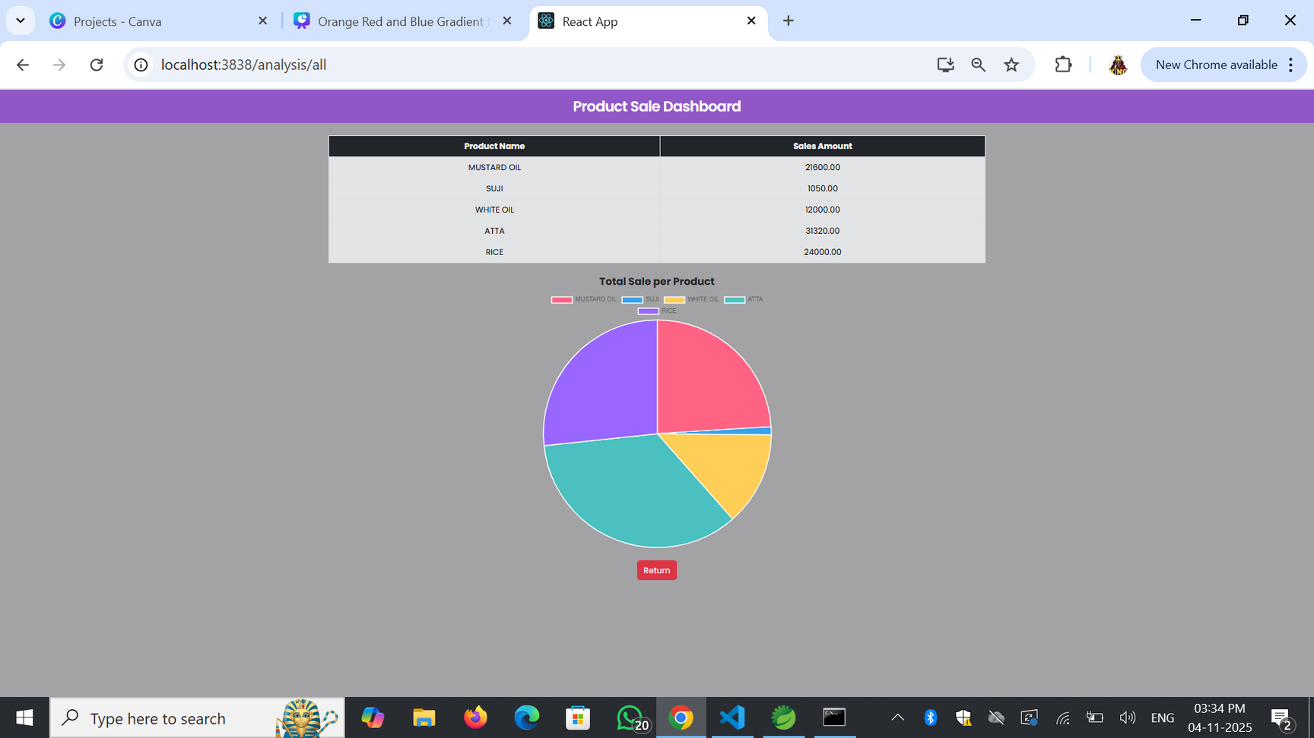
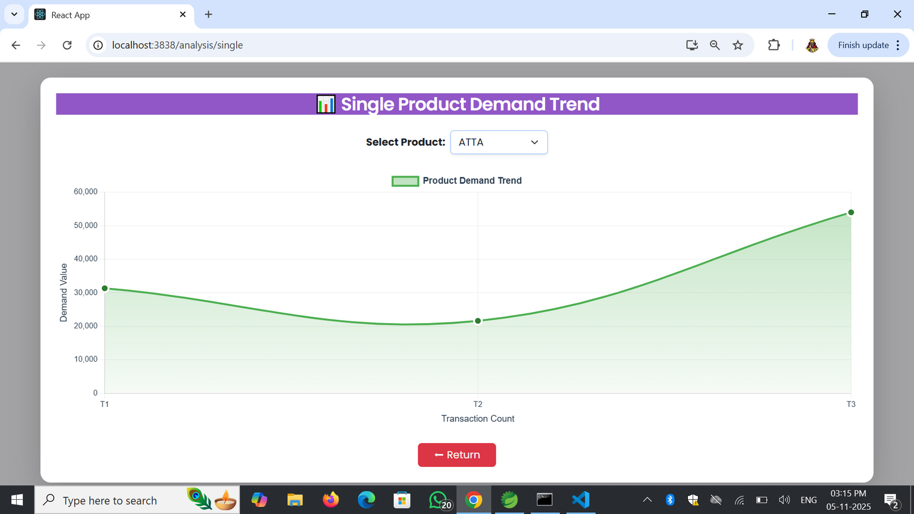
PRODUCT SALE DASHBOARD (ALL PRODUCTS ANALYSIS) :
SINGLE PRODUCT DEMAND TREND :
Displays a visual summary of total sales per product using tables and pie charts, helping in quick comparison of product performance.
Shows demand and sales trend for a selected product through graphical visualization, enabling data-driven decision-making and stock planning.

Slide 10
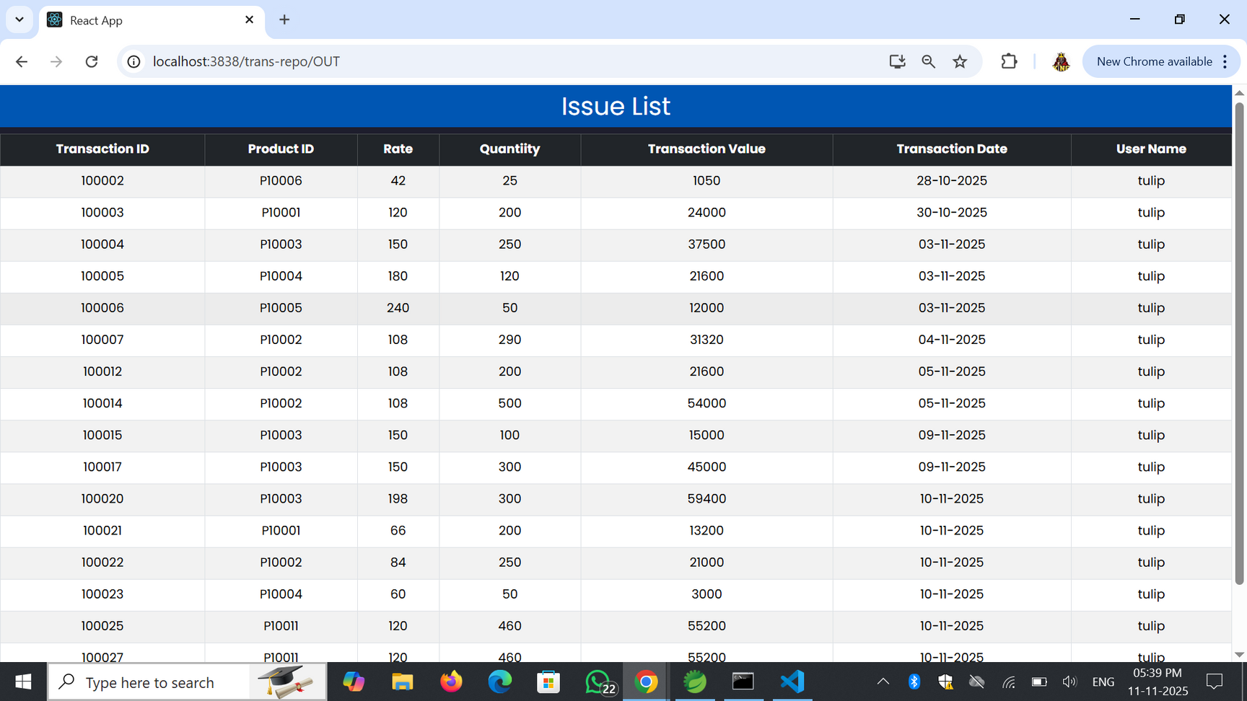
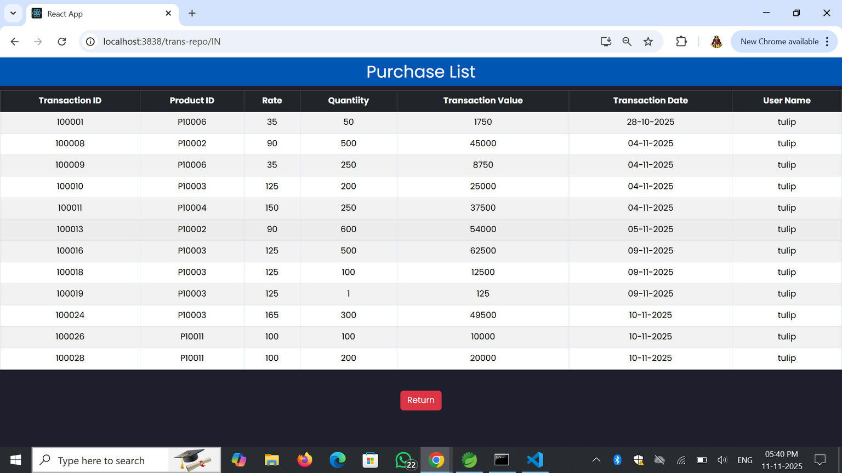
ISSUE LIST:
Maintains a record of all product issue transactions showing rate, quantity, and total value. Assists in monitoring stock outflow and user accountability.
PURCHASE LIST:
Displays all product purchase transactions with details like rate, quantity, transaction value, and date. Helps in tracking stock inflow and purchase history efficiently.

Slide 11
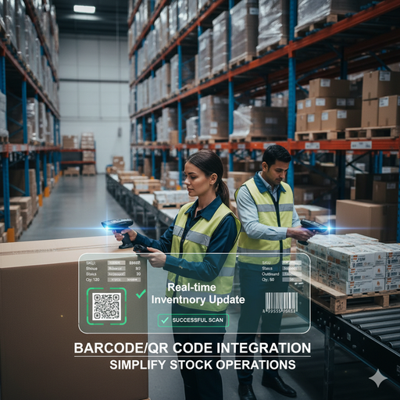




FUTURE ENHANCEMENTS
BARCODE/QR CODE INTEGRATION
AI-BASED DEMAND FORECASTING
AUTOMATED REORDER ALERTS
VENDOR PERFORMANCE ANALYTICS
MOBILE APPLICATION SUPPORT

Slide 12

CONLUSION
CONCLUSION
SmartShelfX – Inventory Forecast & Auto-Restock simplifies the entire product management cycle, from product registration to reporting. It ensures accuracy, transparency, and efficient daily operations through secure, user-friendly modules. By reducing manual errors and improving real-time decisions, SmartShelfX boosts operational efficiency and has strong potential to grow into a complete enterprise management solution.

